Slide 1
Microservices with Spring Cloud

Slide 2
Why are Microservices needed?
What are the challenges associated with them?
How does Spring Cloud help us to solve them?
- Implementing wide variety of Spring Cloud Components

Slide 3
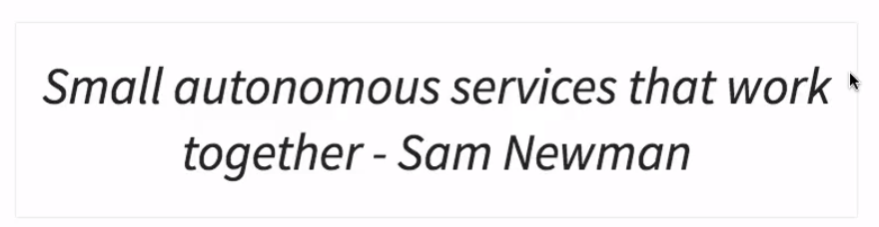
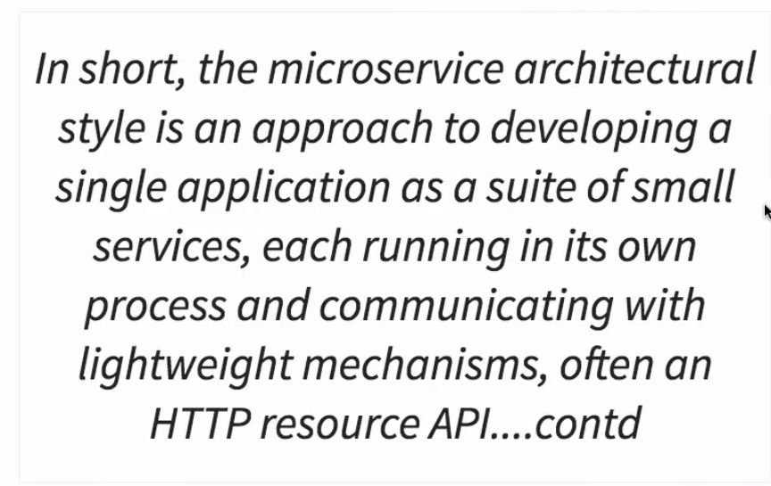
Introduction to Microservices

Slide 4
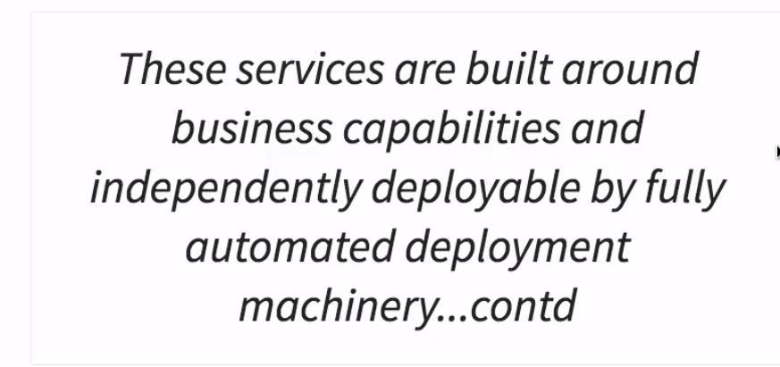
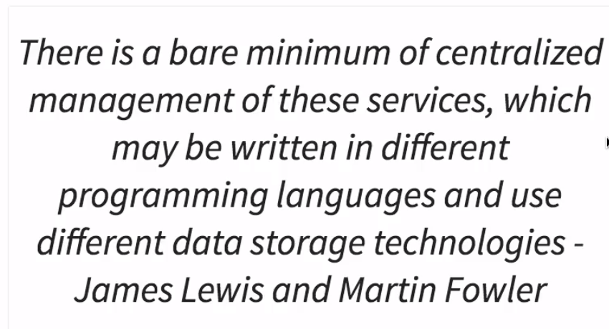

Slide 5
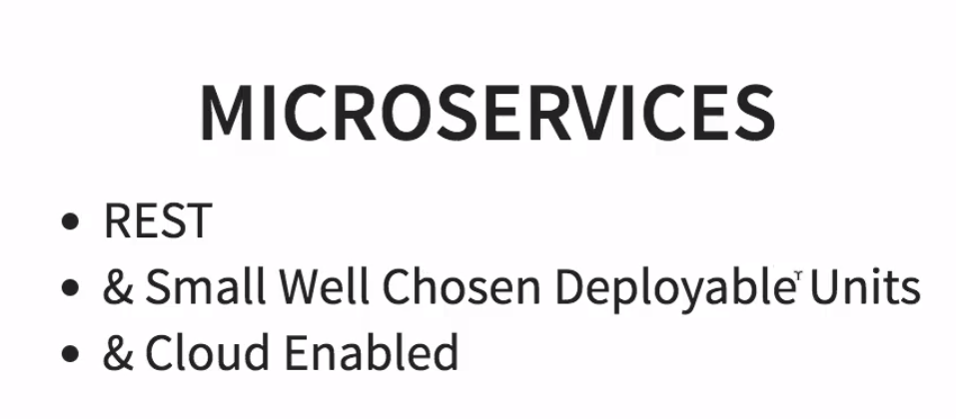

Slide 6
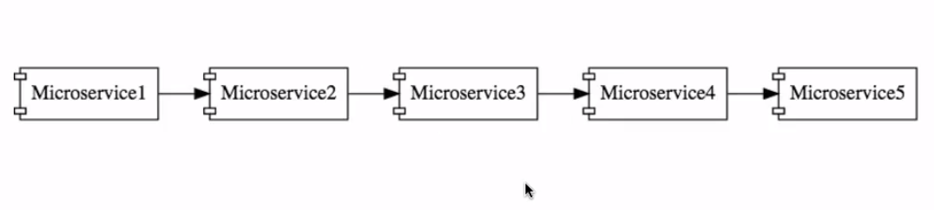
A set of microservices with well defined boundaries, which are interacting with each other.

Slide 7
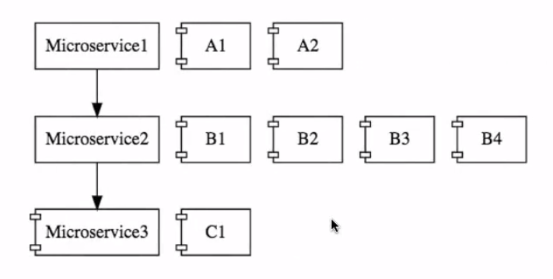
Cloud enabled microservices – multiple instances of each microservices.
Ex: if there is load on microservice 3, we can bring another instance microservice 3 or take down instance of Microservice 2
How to cloud enabled them?
How setup architecture, such that it would be able to dynamically adjust and
be able to bring new instances & take the older instances down.

Slide 8
CHALLENGES

Slide 9

How do you identify the boundary of each of these microservices? How do you identify what to do in each of these microservices?

Slide 10

Each Microservice can have multiple instances in each environment & there are multiple environments Ex: There are 10 microservices with 5 environments, with 15 instances.

Slide 11
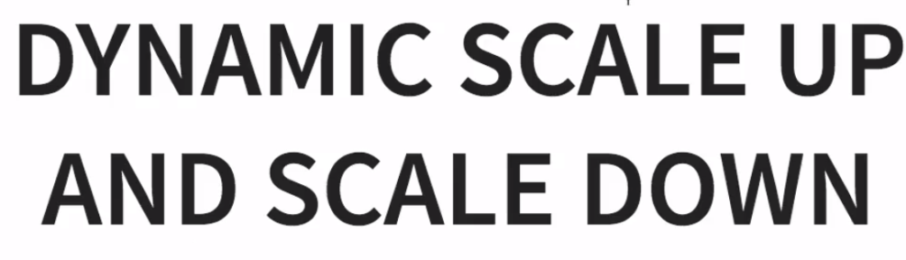
Loads on different microservices will be different at instances of time
Ex: We will bring new instances of microservices up & bring down older instances microservices when they are not really needed ..
and also distribute the load among the new instances..
All with dynamic load balancing

Slide 12

Ex: If the functionality is not distributed among 10 microservices, how will you identify where the bug is?
You need a monitoring around microservies.. .
We need to be able to identify the microservices which are down.
All these kind of things need be automated…

Slide 13


Slide 14

https://spring.io/projects/spring-cloud

Slide 15

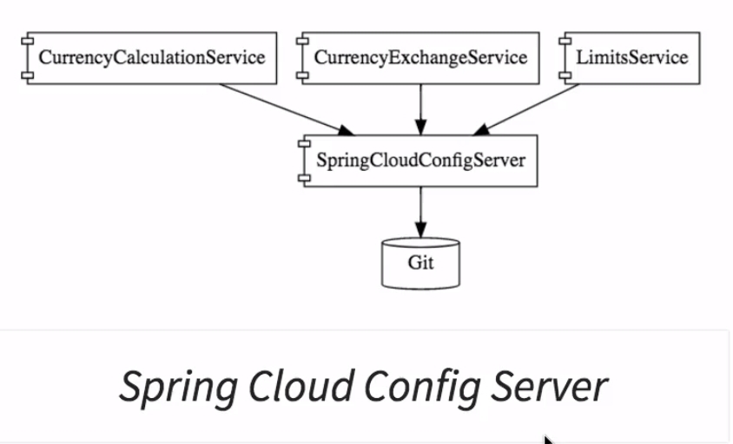
Store all the configurations of all different environments of all the microservices in a git repository.. (centralized)
Spring Cloud Config Server, can be use to expose that configuration to all the microservices

Slide 16
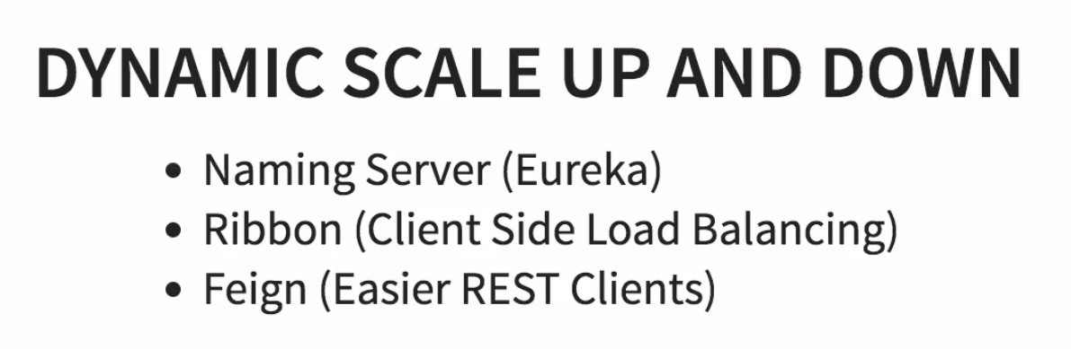
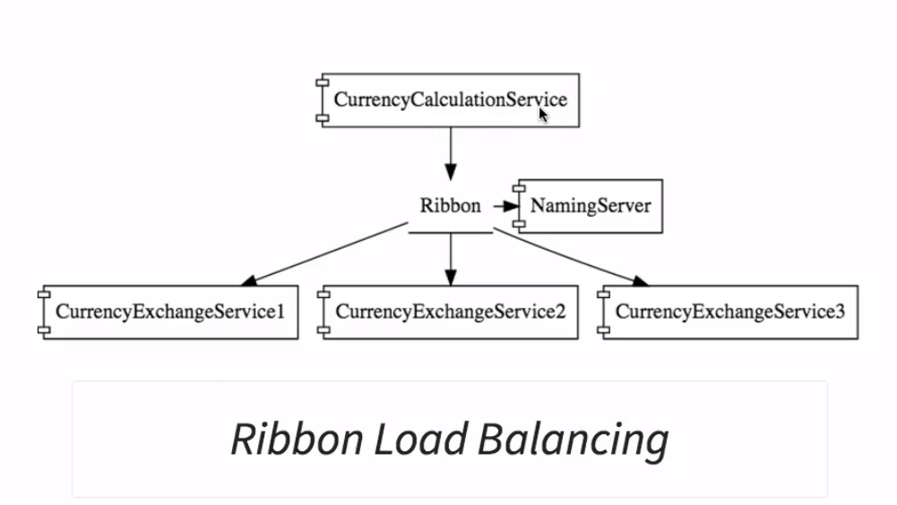
CurrencyCalculationService, should be able to distribute the load between all the instances
All the instances of microservice would register with the ‘Naming Server’
Eureka - Service Registration + Discovery
Ribbon – make sure the load is evenly distributed among the existing instances that it get from the ‘Eureka’

Slide 17
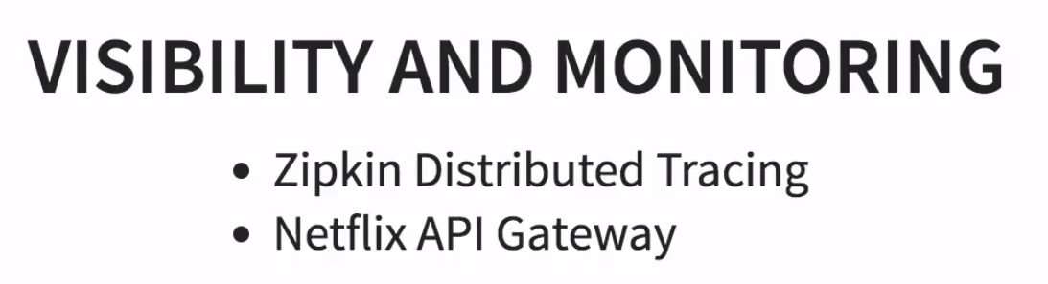

Slide 18
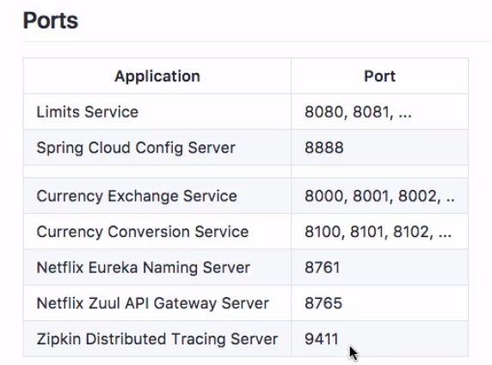
Microservice Components - Standardizing Ports and URL

Slide 19
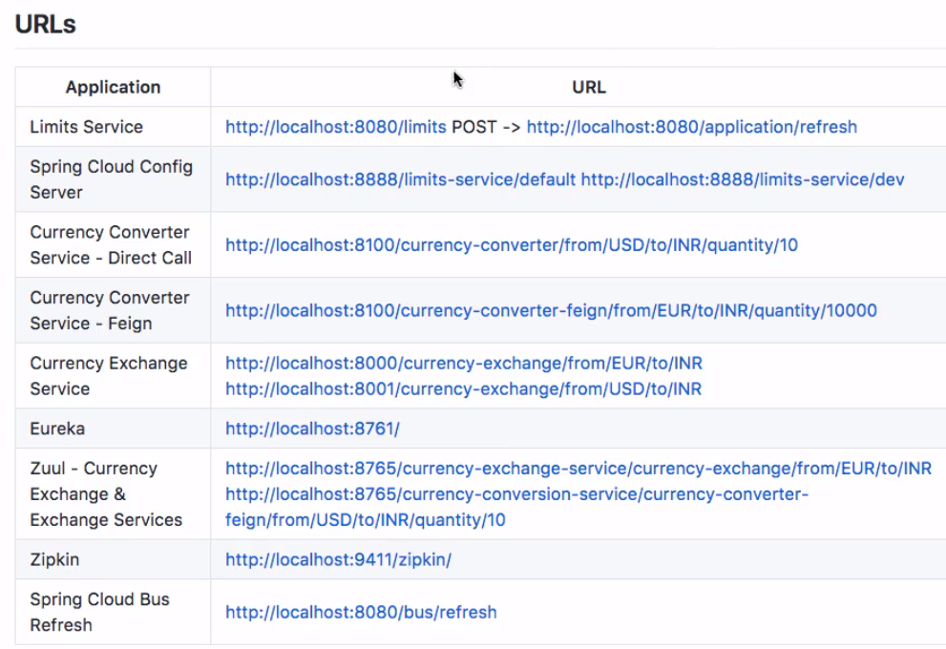

Slide 20
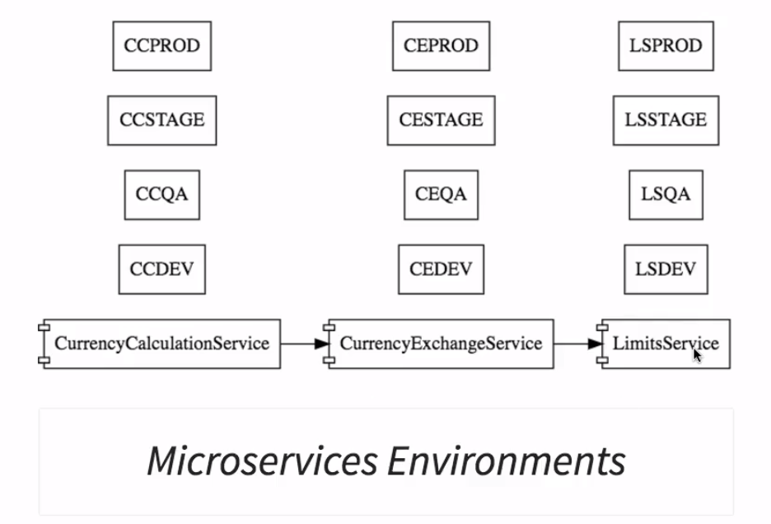
Intro to Limits Microservice and Spring Cloud Config Server
Centralized Microservice Configuration – How Spring Cloud Config Server helps?
- Each Microservice has it’s own config..(ex: DB config, external service config..)

Slide 21
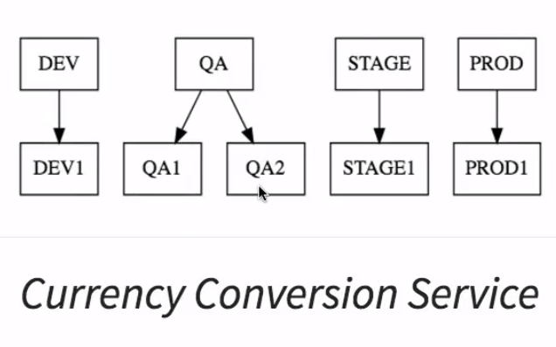
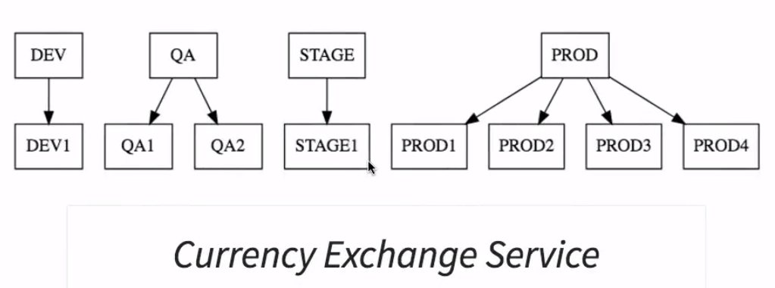
Ex: ‘Currency Exchange Service’ has four production environments.

Slide 22
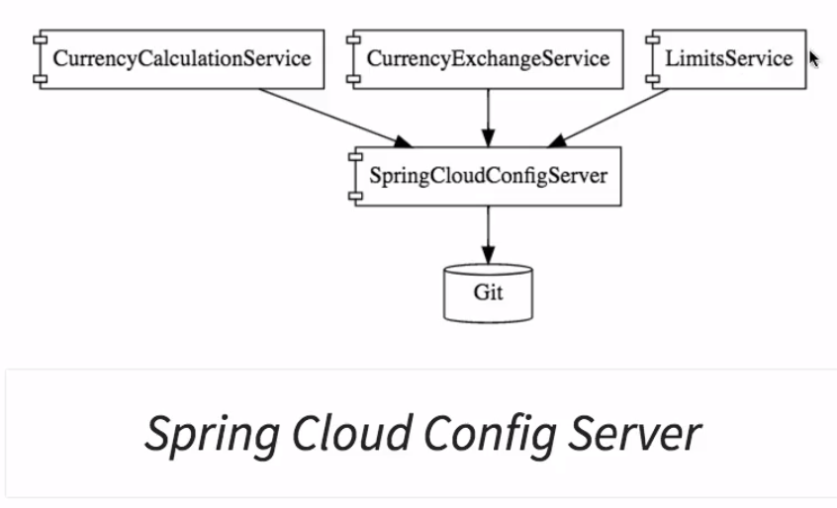
Ex: ‘LimitsService’ says, that I would want the config for ‘Dev’ environment for LimitsService, Spring Cloud Config Server would provide it.
Put all config’s into git repository, connect the Spring Config server to git, it can serve config based on the needs of different instances in different environments.

Slide 23
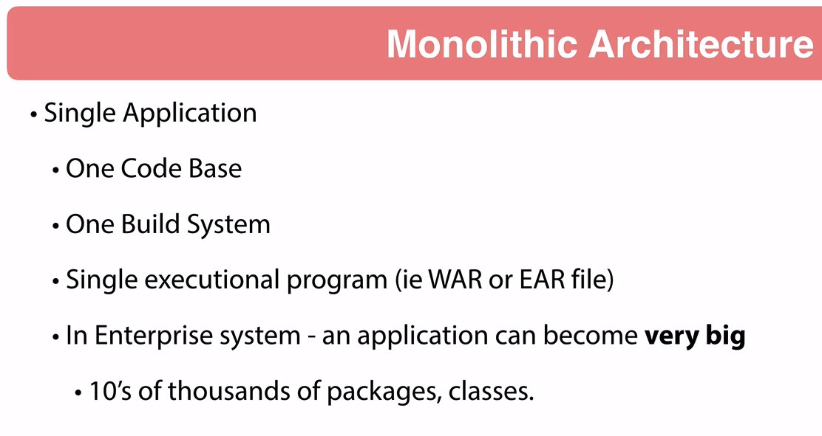

Slide 24
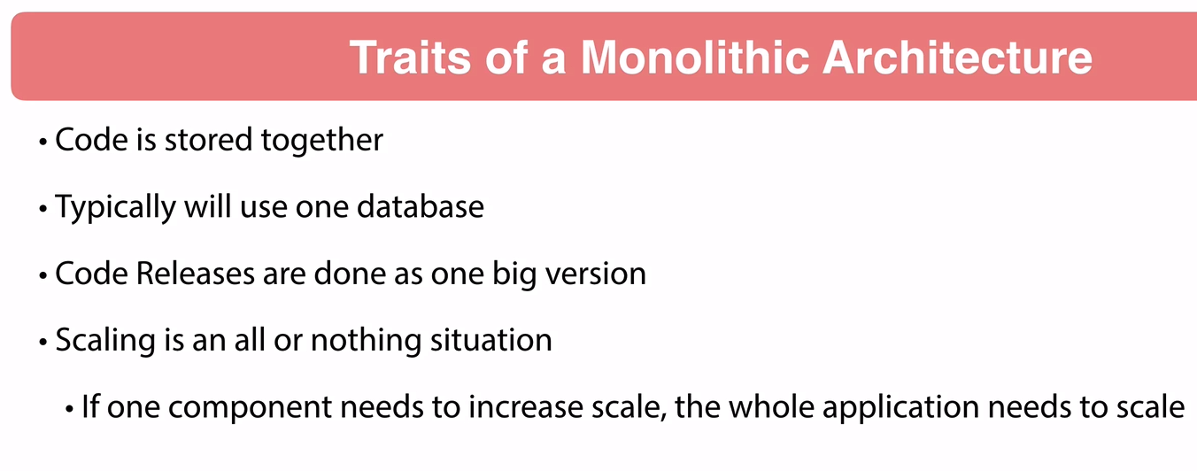

Slide 25
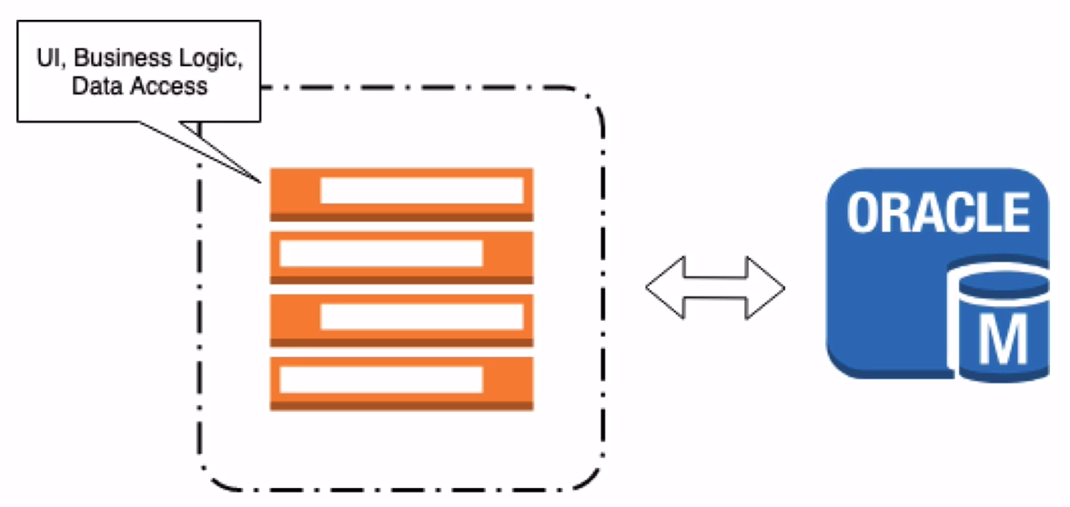

Slide 26
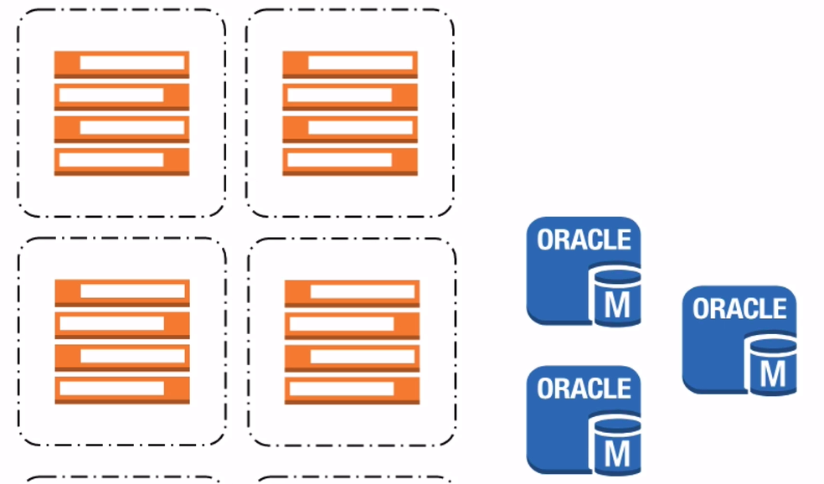

Slide 27
